Slide 1
The Sociological Imagination
Bodies and Embodiement

Slide 2
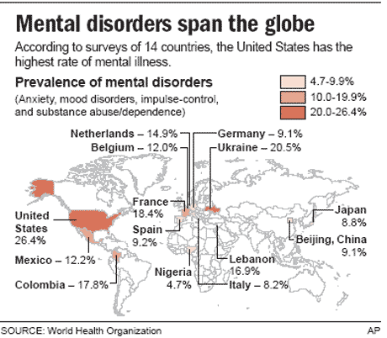
Mental Disorders

Slide 3
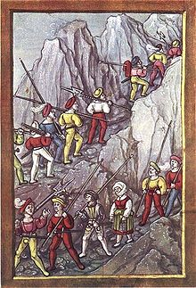
Nostalgia

Slide 4
Melancholia

Slide 5
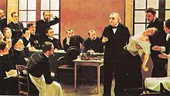
Hysteria

Slide 6
Unique Mental Diseases
Dhat Syndrome, seen pretty much in India and nowhere else, doesn't need a fancy setup to seem bizarre: it's semen-loss anxiety.
Dhat sufferers believe they are leaking semen (not like dripping into their pants, they think they're losing it when they urinate) and that this loss is weakening them both mentally and physically.

Slide 7
Unique Mental Diseases
You've heard the term "running amok," but the word "amok" is Malaysian, and originally described elephants going mad and separating from their herd.
We're talking about random, kill-crazy outbursts by males with non-violent histories who, with absolutely no provocation, will suddenly up and decide that not enough of everything is dying and do their level best to rectify that situation.

Slide 8
Unique Mental Diseases
Koro means "head of the turtle" in Malay. Koro is also known as genital retraction syndrome.
The sufferers of this mental disorder are under the illusion that their penis is now not only shrinking, but actually retracting into their bodies.

Slide 9
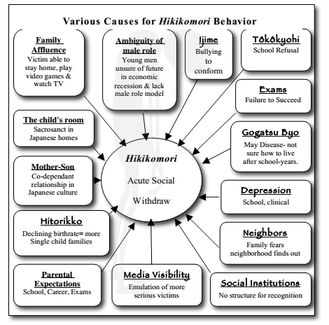

Slide 10
Autism Evolution

Slide 11
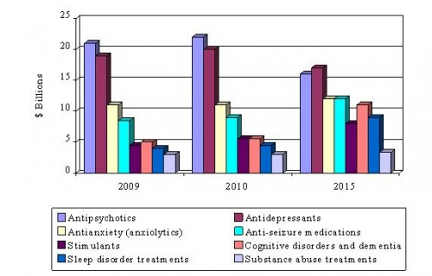
SUMMARY FIGURE GLOBAL MENTAL HEALTH PHARMACEUTICAL INDUSTRY BY DRUG CATEGORY, 2009-2015 ($ BILLIONS)

Slide 12
Antidepressants
Antidepressants Market Share by Revenue, 2008
Rank | Market Share | Company | Product | Revenue ($ billion) | Growth
1 | 36.1% | Wyeth | Effexor | 3.93 | 3.7%
2 | 24.8% | Eli Lilly | Cymbalta | 2.7 | 28.6%
3 | 21.1% | Forest Laboratories | Lexapro | 2.29 | 9%
4 | 10.8% | GlaxoSmithKline | Paxil, Wellbutrin | 1.17 | (-21%)
5 | 5% | Pfizer | Zoloft | 0.54 | 1.5%
6 | 2.2% | Schering-Plough | Remeron | 0.24 | N/A

Slide 13
The Value of a Human Body
The US Environmental Protection Agency has calculated the value of a human life at $9.1 million, up from $6.8 million during the Bush era. The Food and Drug Administration's current estimate is $7.9 million, up from $2.9 million since 2008. Meanwhile, the transportation Department is sticking with its $6 million figure. Generally though, experts say the long-term trend is upward, with top human matter fetching big dollars. A lung alone goes for over $100,000 USD. Add to that bone marrow, extracted antibodies, blood and sperm donations, female eggs, bio-voltage, medical testing opportunities, lifetime taxation, ears, eyes, knees, hearts, livers and future earning potential and it all starts to add up.

Slide 14
The Value of a Human Body
The only real authority on a human body's worth is the periodic table. It says a corpses’ raw resources are worth about a dollar. Sulfur probably has the most value once the water is drained. It’s used to make matches. That said, there is still reason to believe in a corpse's inflated worth. A recent report financed by the Department of Homeland Security suggested that preventing a death from terrorism now costs 100 percent more than other deaths. Invest in sulfur.

Slide 15
Plastic Surgery

Slide 16
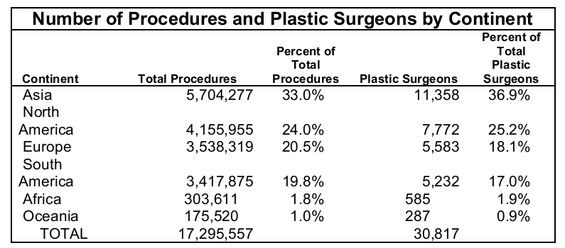
Plastic Surgery

Slide 17
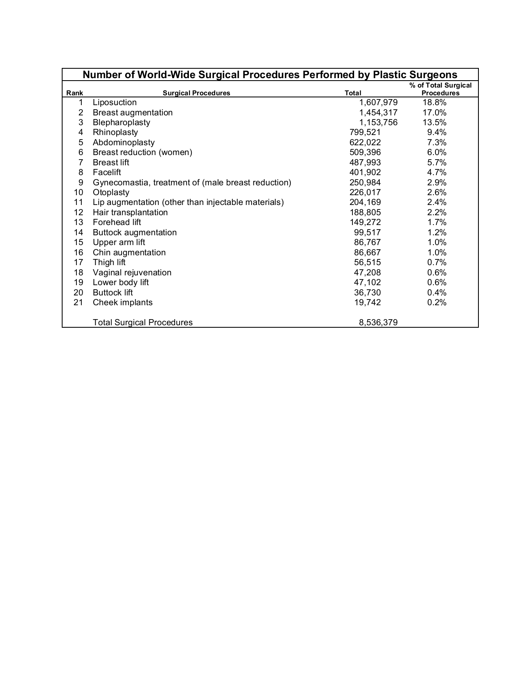

Slide 18
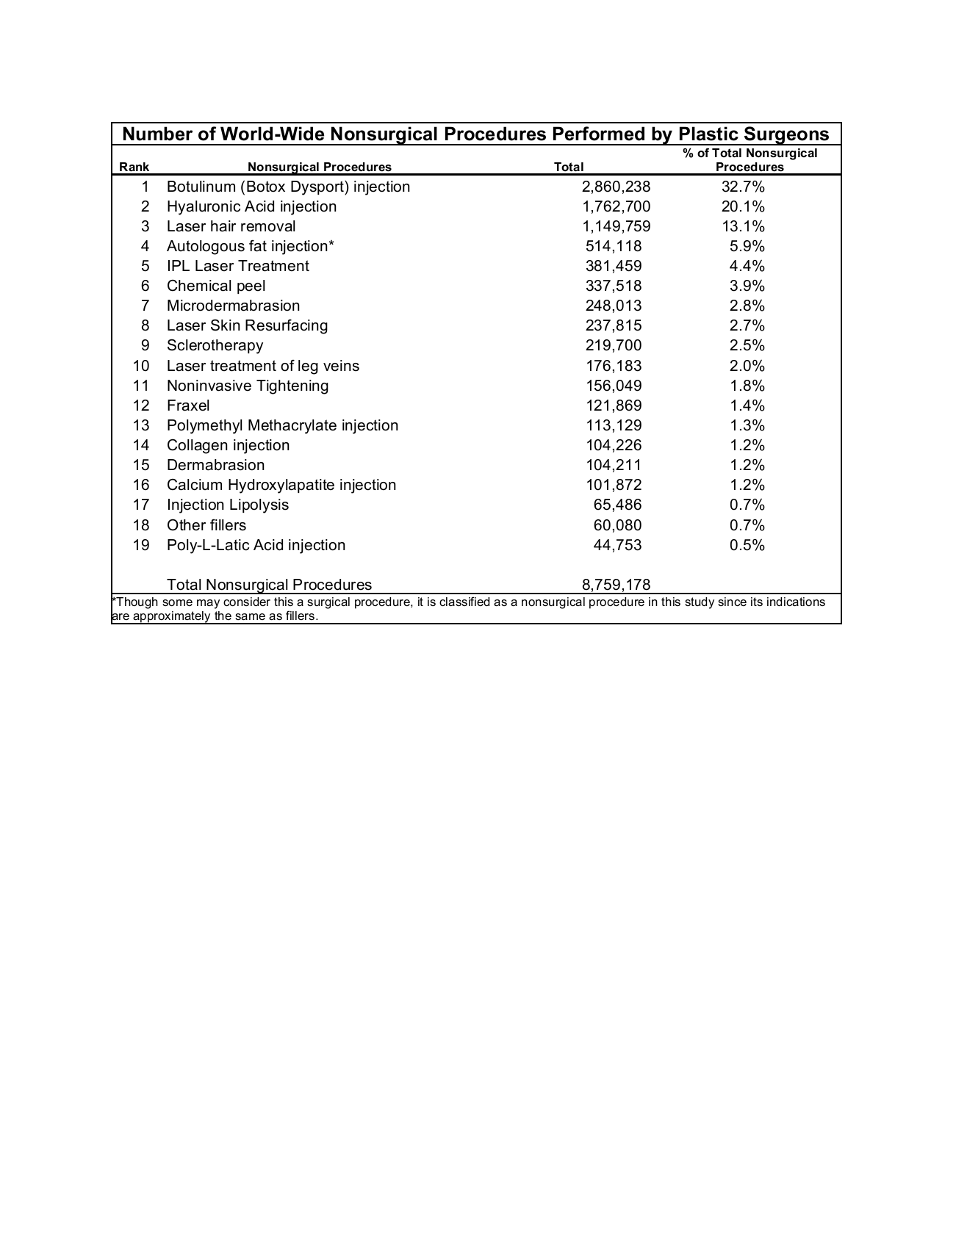

Slide 19
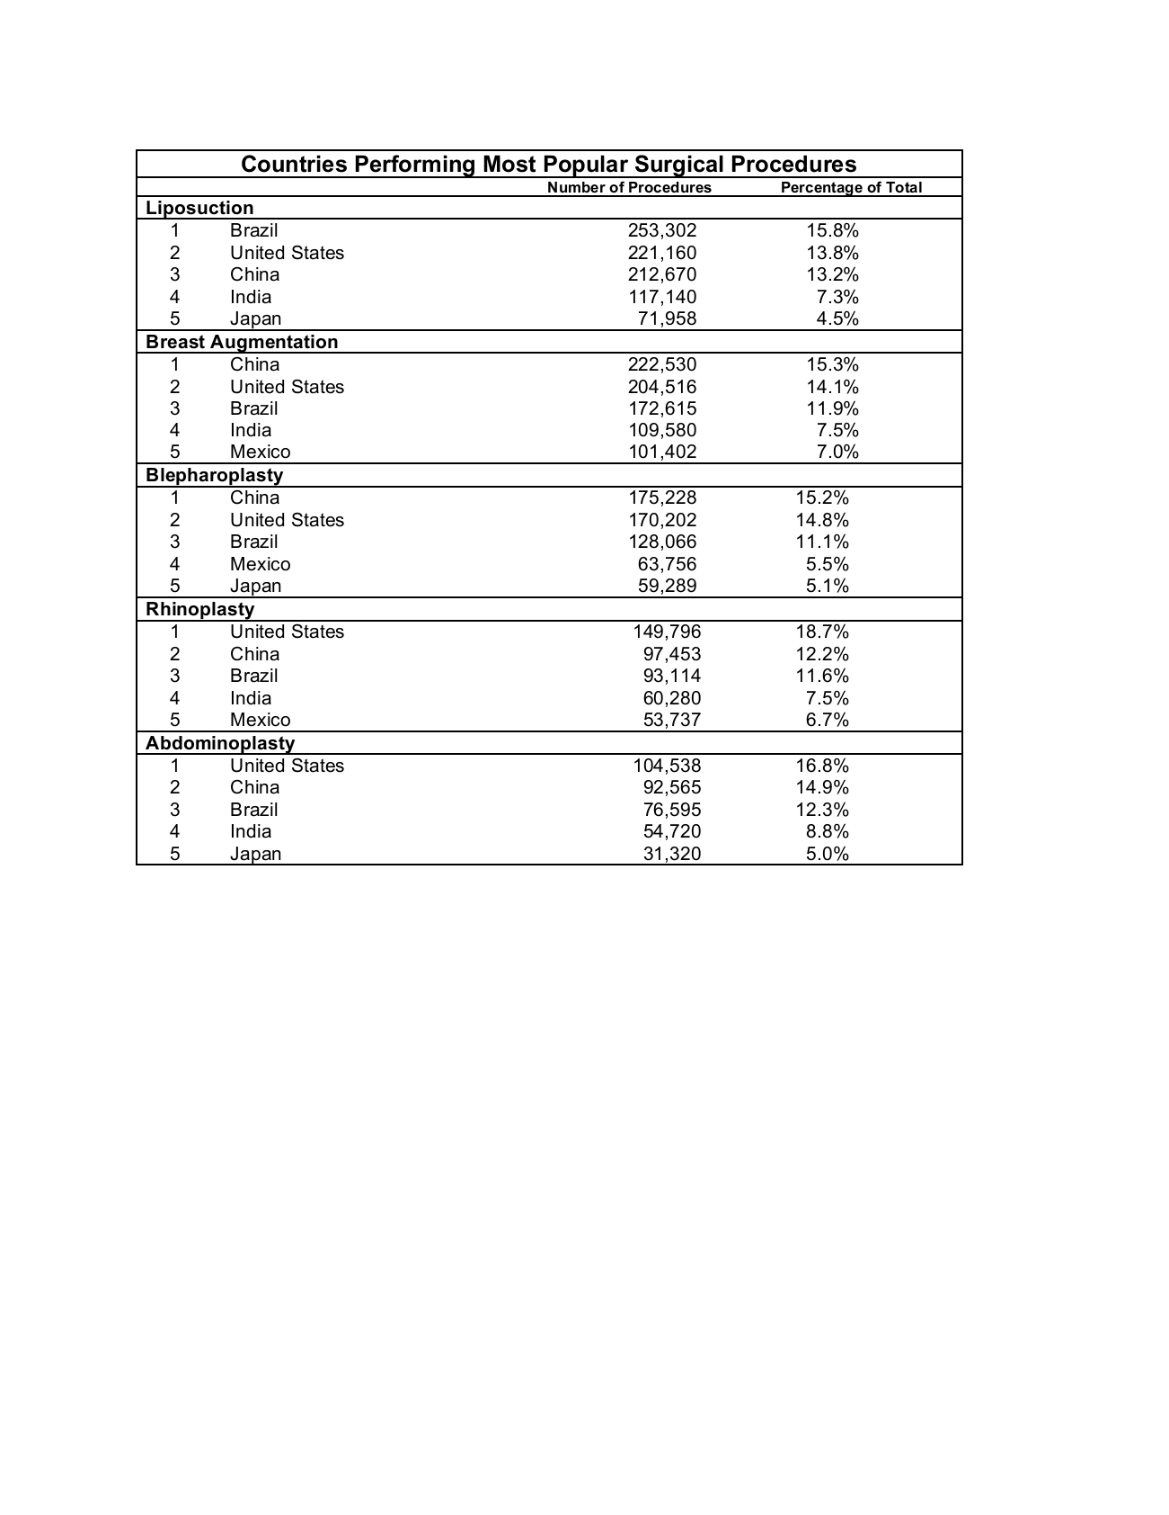

Slide 20
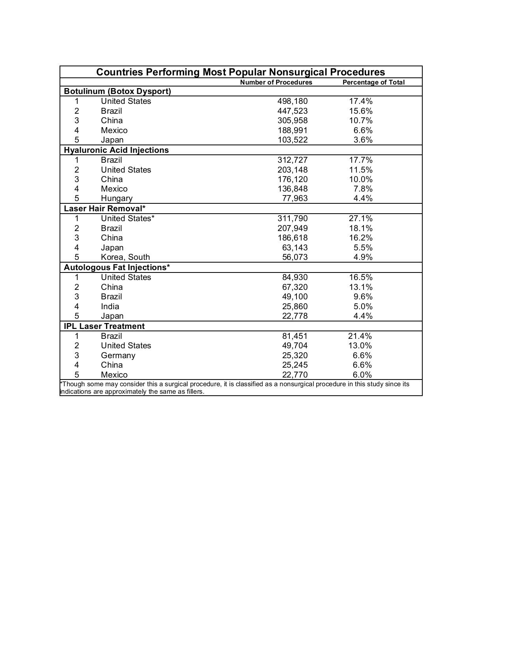

Slide 21
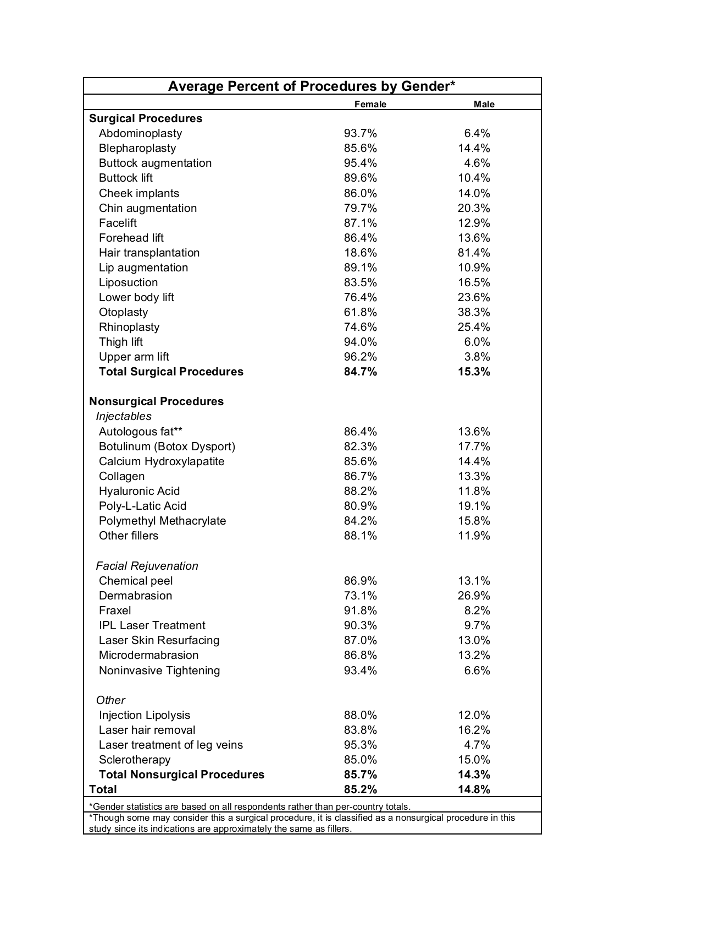

Slide 22
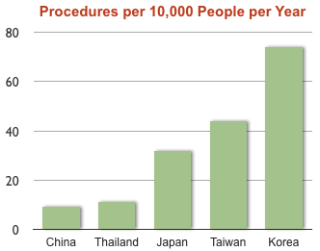
Highest Plastic Surgery Rates for 2009

Slide 23
Plastic Surgery
Country | Total Procedures | Total Population | PP10K
South Korea | 365,000 | 49,232,000 | 74
Brazil | 1,054,000 | 193,000,000 | 55
Taiwan | 103,000 | 22,929,000 | 44
United States | 1,300,000 | 309,000,000 | 42
Japan | 411,000 | 127,288,000 | 32
Thailand | 76,000 | 65,500,000 | 11
China | 1,215,000 | 1,322,000,000 | 9
India | 683,000 | 1,184,000,000 | 6
PP10K = procedures per 10,000 people of all ages per year

Slide 24
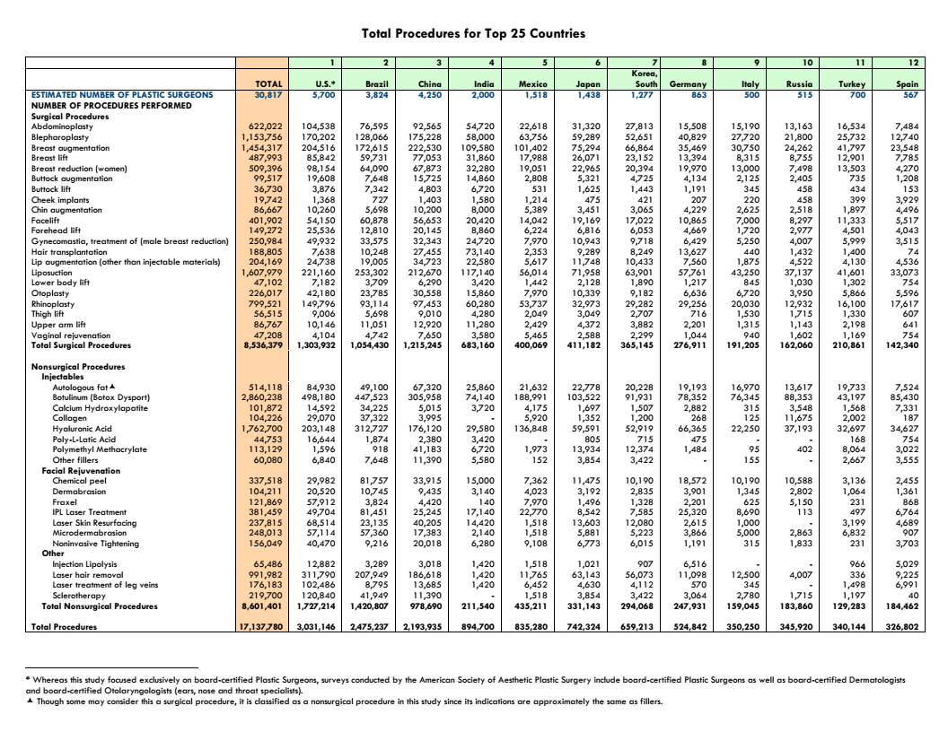

Slide 25
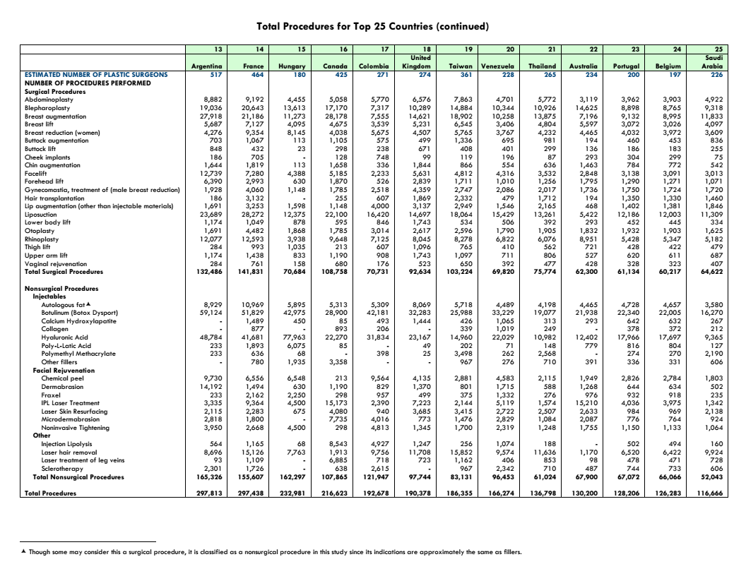

Slide 26
Improvement Catalog

Slide 27
Giraffe Women

Slide 28
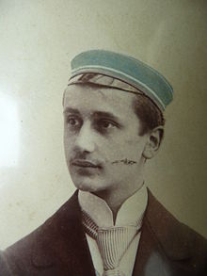
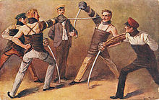
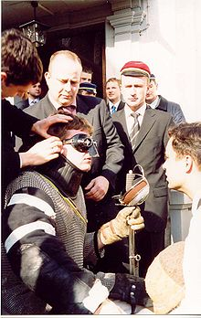
Mensur

Slide 29
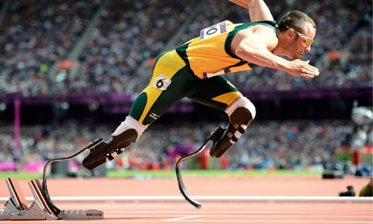
Body Enhancement

Slide 30
Body Enhancement

Slide 31
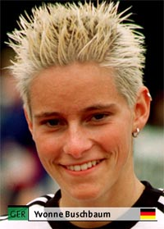
Crossing Boundaries

Slide 32
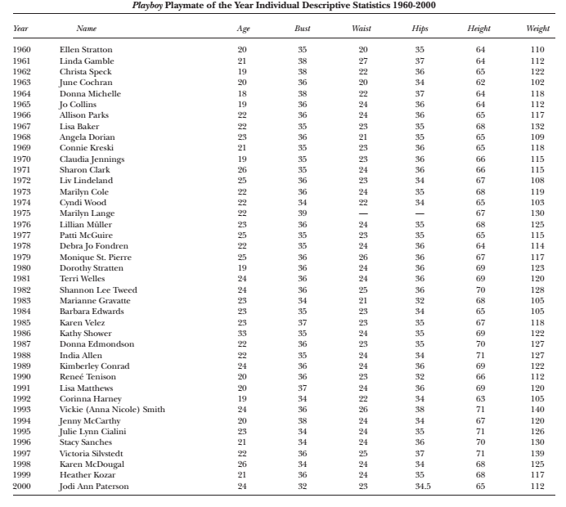

Slide 33
Who Earns More?

Slide 34
Funding Medical Research
Total Federal spending on AIDS/HIV FY 2009 = 24.1 billion
Total Federal spending on cancer (all types) = 4.81 billion
Number of new breast cancer cases/ deaths 2009 = 207,090/39,840
Number of new prostate cancer cases/deaths 2009 = 217,730/32,050
Number of new lung cancer cases/deaths 2009 = 222,520/157,300
Funding 2009 for breast cancer = 599.5 million
Funding 2009 for prostate cancer = 293.9 million
Funding 2009 for lung cancer = 246.9 million

Slide 35
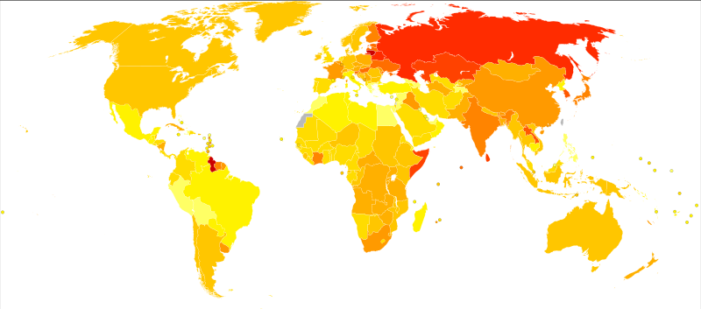
Suicide Rates

Slide 36
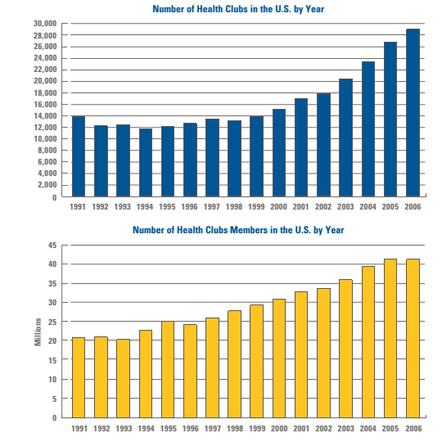
Health Clubs (USA)

